Slide 1
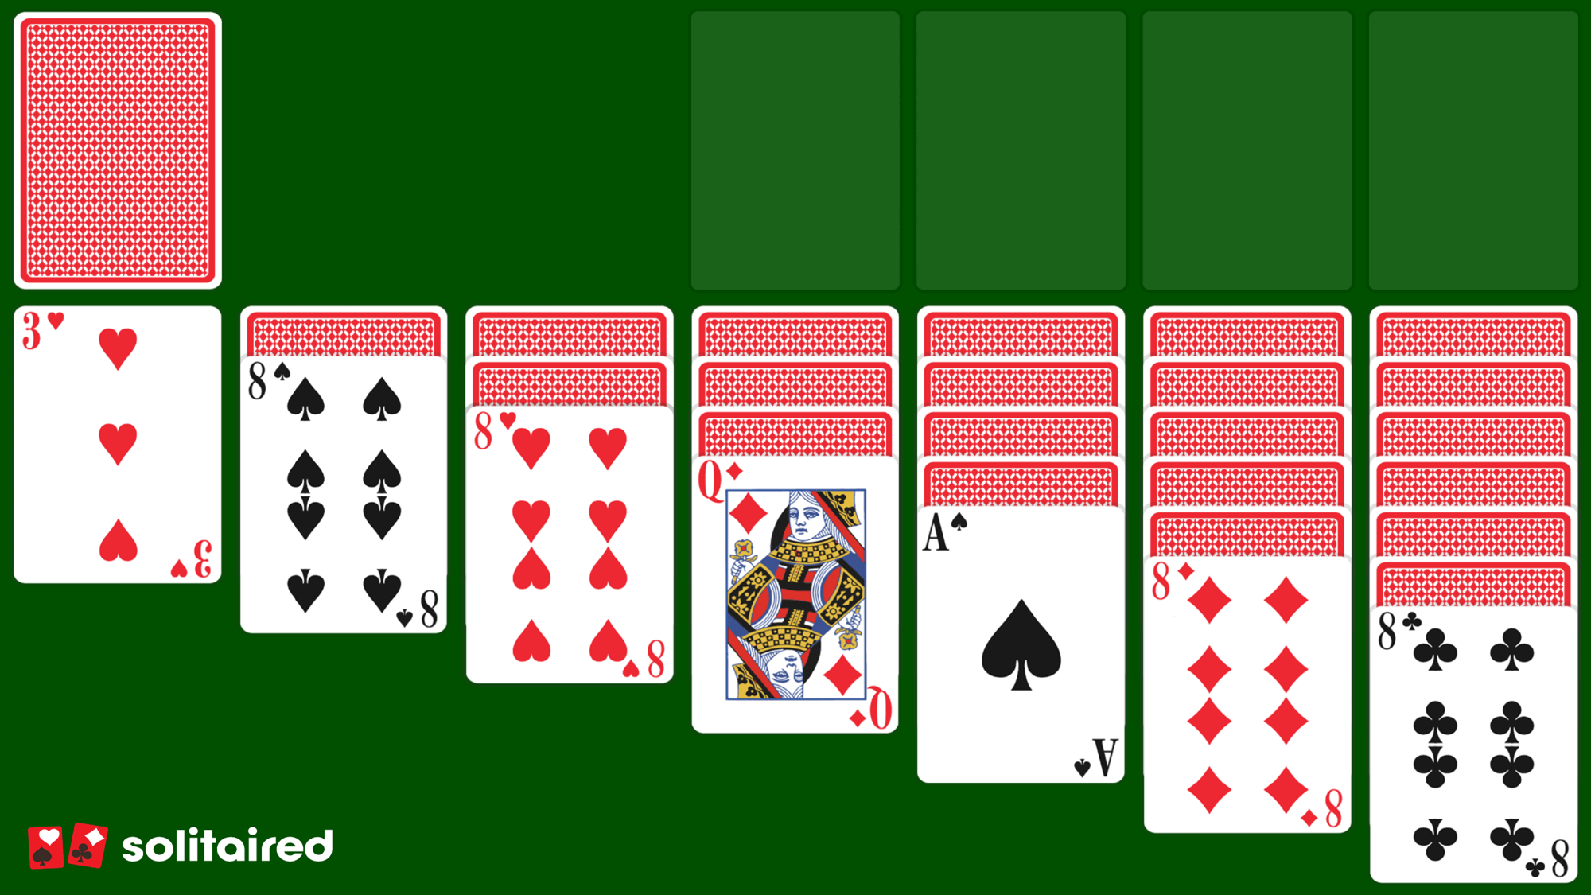
Solitaire

Slide 2
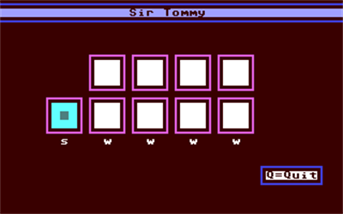
Introduction
Solitaire is a card game that is only played with the objective of using up all ones cards to form particular arrangements and sequences.
The Card game is for a single player. The word Solitaire is of French origin and it means patience.
Historical fact:
Solitaire was originated towards the end of the 18th century, in the Baltic region of Europe and was used for fortune telling.

Slide 3
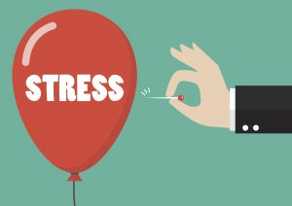
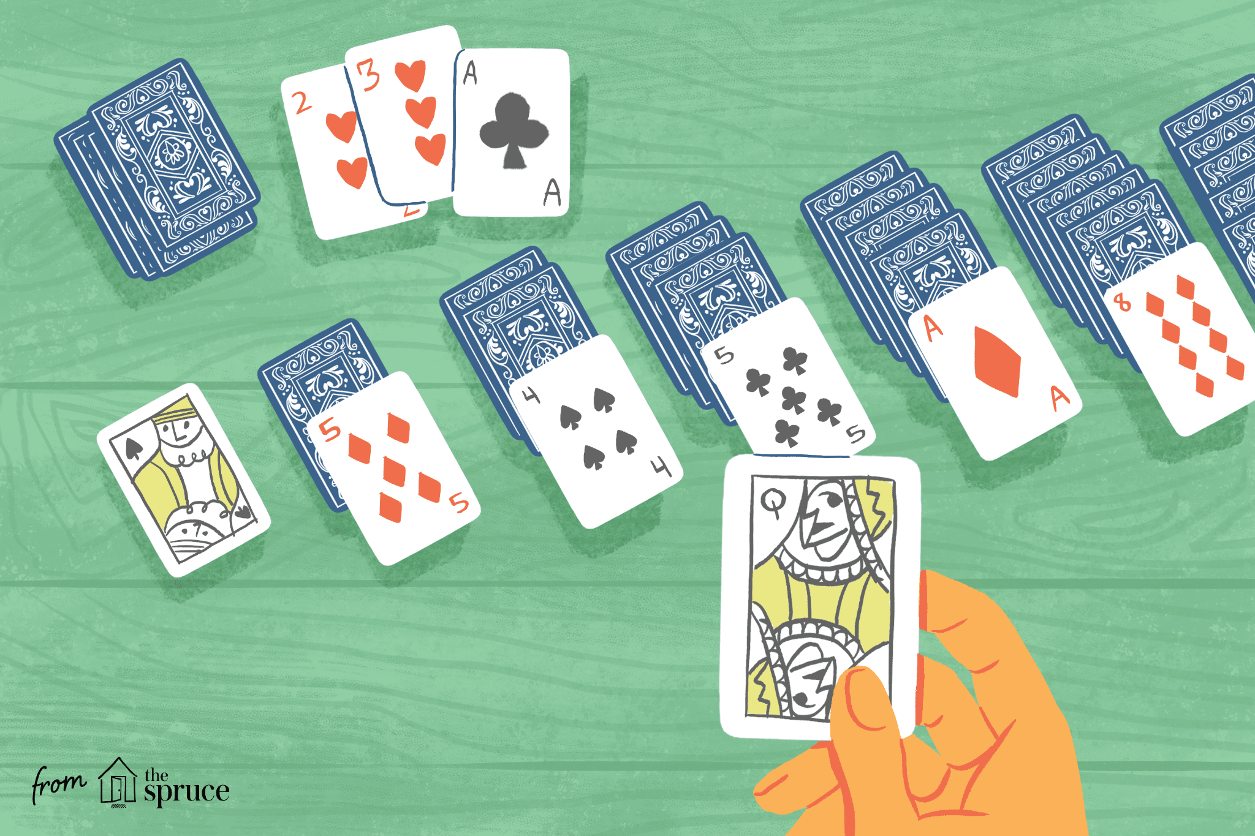
Executive Summary
Solitaire—a classic solo card game
Generally is a fairly simple game with simple rules, so the purpose of the game is to be a destressor and a way to combat boredom. Not only is it useful for relieving stress, it also has the advantage of “exercising” the brain.

Slide 4
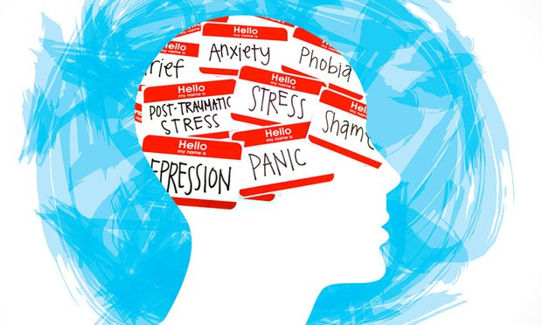
Background of Problem
In reality everybody goes through daily stresses and long periods of time with nothing to do.
These things can be a source for anxiety and other mental problems.
Games can act as ways to help deal with these issues
They can act as an outlet for these negative emotions and help combat these stresses
They take their mind away from these issues
and gives the person something that is fun
and not stressful

Slide 5
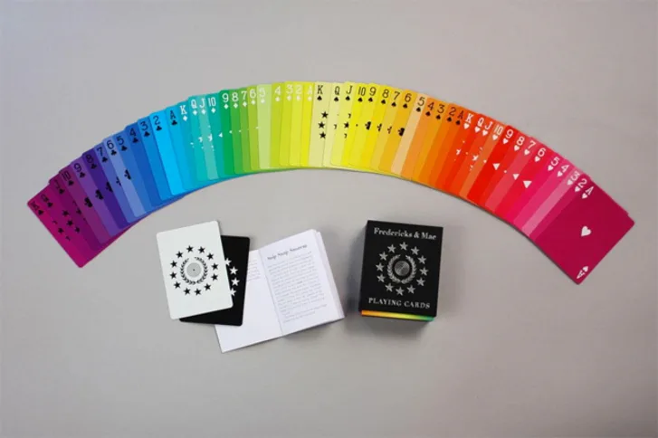
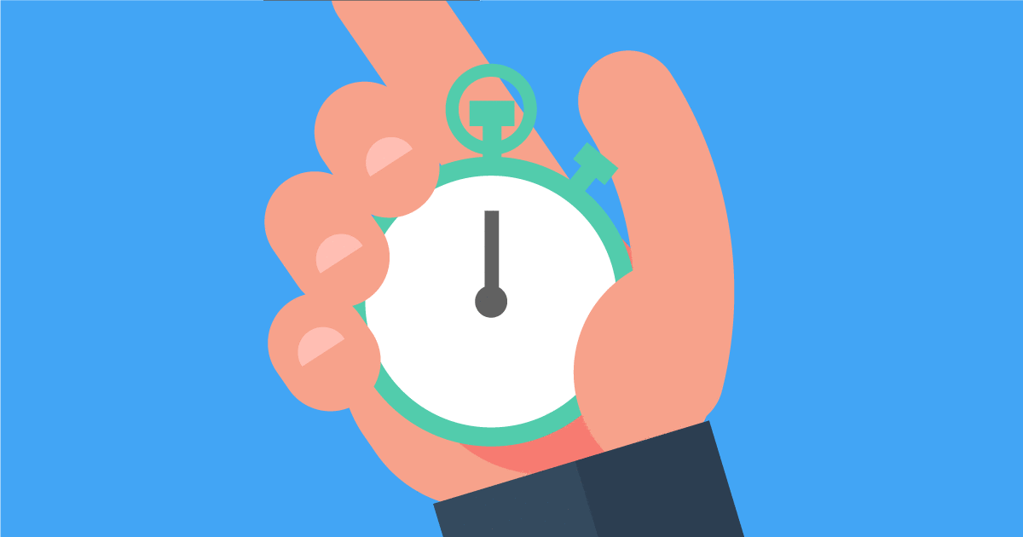
Our Solution
By making Solitaire we aim to have an easy-to-understand game, that can be both calming and challenging.
Extra challenge additions may include:
Time limits
Special rules
High scores
We would also like to implement “themes” for the cards in the game (standard cards, black cards, colorful cards, etc.)

Slide 6
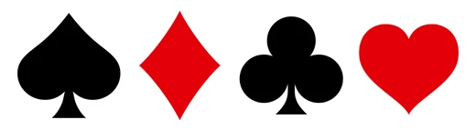
SUCCESS CRITERIA
Have a completed Solitaire game application.
It should have no glitches or bugs (like cards disappearing or the player getting soft locked because they did a wrong move, things of that sort).
It also should have options of restarting the rounds or exiting, and once there are no possible moves to be made to have a message that alerts the player of this (a.k.a. they lost the round).

Slide 7
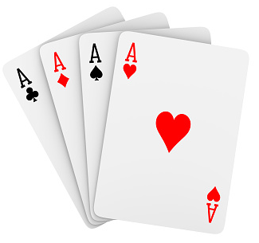
RESOURCES
Netbeans
Websites (such as Stack Overflow)
Some help from the book
Solitaire game rules (just the standard rules of the game and maybe game modes)

